Slide 1











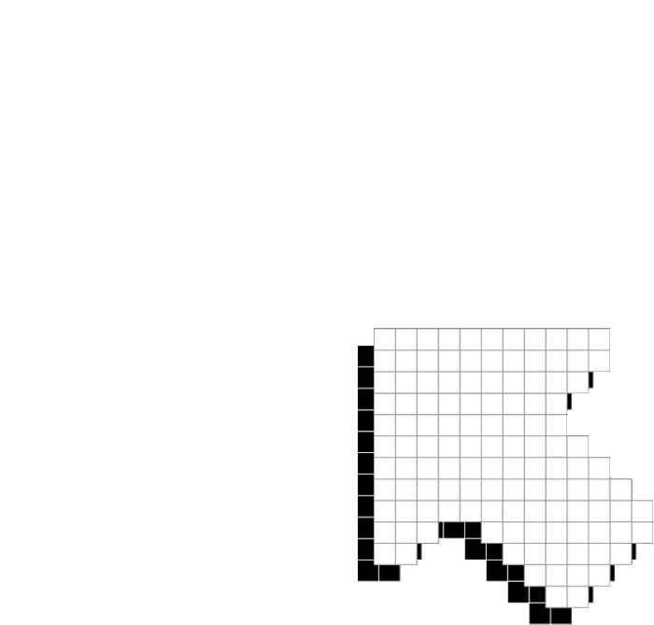


PLAYER 1
HIGHSCORE 2500
PLAYER 2
DEVELOPER’S CHOICE
A Data-Driven Exploration of Steam Games

Slide 2








TEAM
DATA DUCKLINGS
Fernanda Rivera
Regina Santos
Victoria Tran
BS Management Information Systems
MS Management Information Systems
MS Management Information Systems

Slide 3













01
07
12
AGENDA
DISCUSSION INCLUDES:
overview
Trends Analysis
insights
recommendations

Slide 4











OVERVIEW

Slide 5



01
07
12
DIVE INTO THE WORLD OF STEAM GAMES
identifying popular genres and emerging subgenres.
price forecasting for game genres.
used python to preprocess and clean data.
utilized tableau for data visualization.

Slide 6
TRENDS ANALYSIS

Slide 7

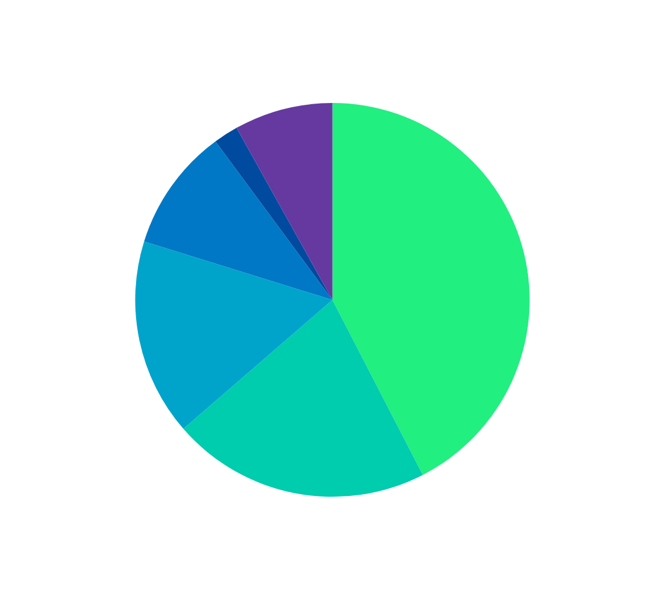
HIGHSCORE 2500
PLAYER 2
TOP 5 GAME GENRES
Simulation 2%
majority of the games on steam fall under these genres

Slide 8


Trend analysis
Tableau

Slide 9
INSIGHTS

Slide 10
KEY FINDINGS
01
07
12
consistent price increase across various game genres.
action genre emerged as a frontrunner in the gaming industry.
uncovered emerging sub-genres within the Action category.

Slide 11
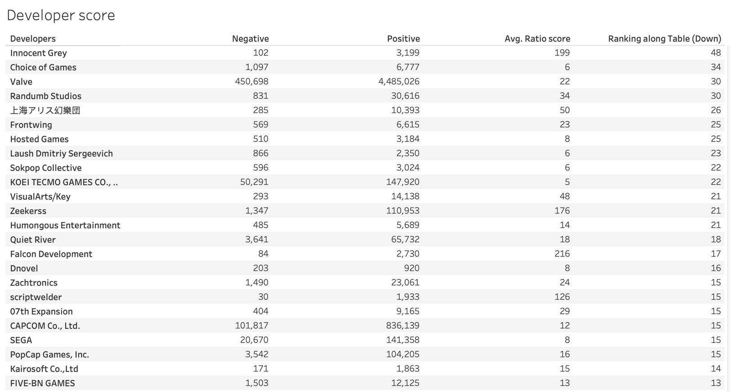



KEY FINDINGS
01
07
12
Top Developers ranking

Slide 12
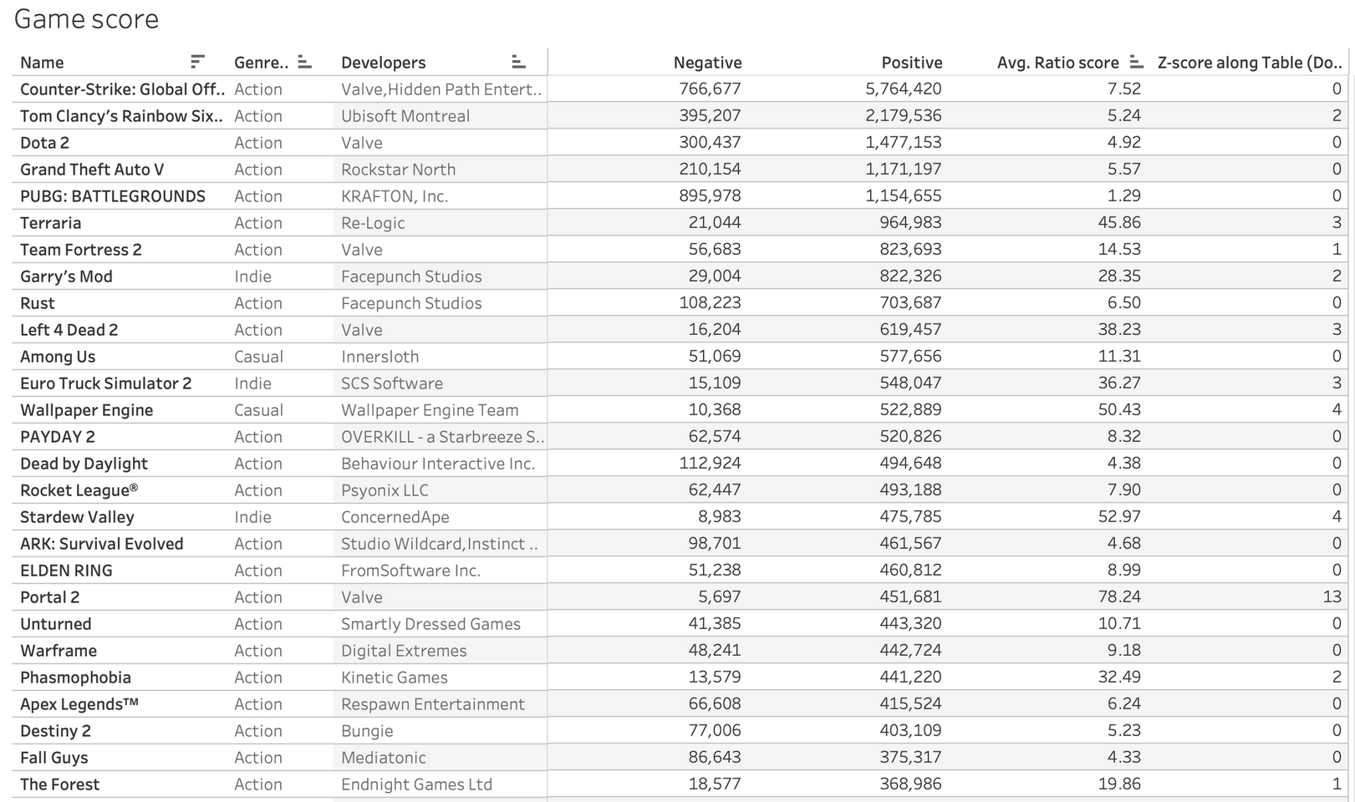



KEY FINDINGS
01
07
12
Top Games score

Slide 13
RECOMMENDATIONS

Slide 14



TO THE DEVELOPERS...
Develop pricing strategies.
Anticipate game development Trends.
create unique and competitive game experience.

Slide 15



PLAYER 1
THANK YOU!
LET US CELEBRATE THE DISCOVERIES MADE, THE HYPOTHESES TESTED, AND THE OUTLIERS EMBRACED!
WINNER!

Slide 16


RESOURCE
Page
https://www.kaggle.com/datasets/fronkongames/steam-games-dataset/data
https://public.tableau.com/app/profile/victoria.tran6504/viz/DeveloperChoice2/Dashboard12
https://gamerant.com/valve-video-game-success-half-life-portal-team-fortress-left-4-dead-steam-values/

